Slide 1
Structure and Pointers

Slide 2
Structure
Pointer
Methods of memory allocation
Operations on pointers
Pointer and Array
Pointer and String
Pointer and Structure

Slide 3
Structure

Slide 4
Array
Derived data type
Used to store group of similar type of data
10
5
4
0
A
A[0]
A[1]
A[2]
A[3]
Structure
Derived data type
Used to store group of different types of data
Def : used to represent a collection of logically related data items
Roll
Name
DOB
Addre
int
char
int
char

Slide 5
Structure Definition
Keyword : Struct
Structure members variable : variable inside structure definition
Roll
Name
DOB
Addre
int
char
int
char
Struct strcture_name
{
datatype variable;
datatype variable;
datatype variable;
};
struct strdate
{
int roll;
char name[10];
int dob;
};

Slide 6
Accessing elements of a Structure
Accessing using dot / period (.) operator
(Objuct)(operator)(member variable)
S1.roll
S1.name
struct student
{
int roll;
char name[10];
int dob;
}s1,s2,s3;

Slide 7
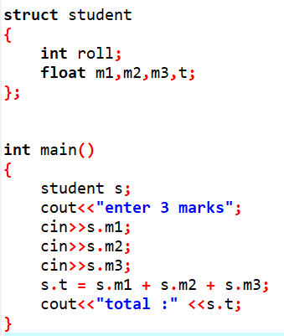
Example 1
Write a program to add 3 mark of a student
Declaration : introduce to compiler
Definition : make a meaning
Accessing : use

Slide 8
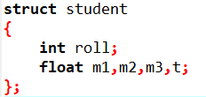
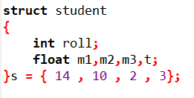

Variable initialisation
During the declaration of variable , we can set initial value
Int x = 10;
Int arr[4] = [10, 12, 30, 8 ]

Slide 9
Memory allocation
Total of individual datatypes used in the structure
2 x 1
1 x 10
4 x 1
Roll
Name[10]
mark
student
int
char
float
int
char
float
struct student
{
int roll;
char name[10];
int dob;
};

Slide 10
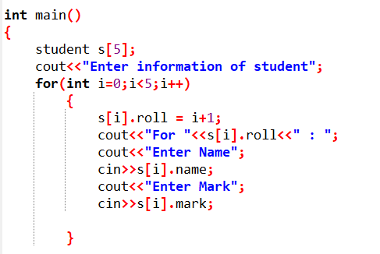
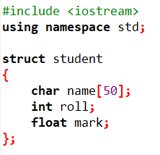
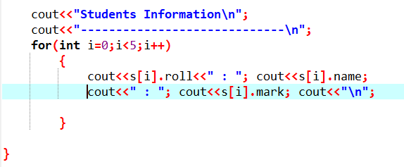
Example 2
Write a program to store Students information
Structure array

Slide 11
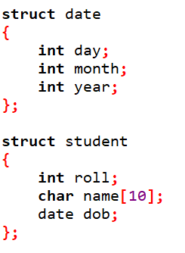
Nested structure [ def 1 ]
A structure declare with the another structure datatype
day
month
year
int
int
int
Roll
Name[10]
dob
int
char
date

Slide 12
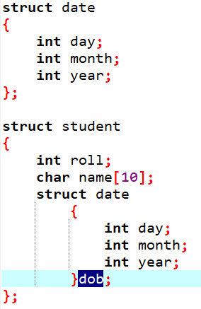
Nested structure [ def 2 ]
day
month
year
int
int
int
Roll
Name[10]
dob
int
char
date

Slide 13
Array vs. Structure
Derived data type
Collection of same type of data
Elements are accessed by using an integer index
multidimensional array : when an array element contain another array
User defend data type
Collection of different type of data
Elements are accessed by using dot(.) operator
Nested structure : when a structure element contain another structure

Slide 14
Pointer

Slide 15
Variable and address
Every variable is a memory location
Every memory location has unique address
The address can be accessed using ampersand ( & ) operator
10
5
4
var
1001
1002
1003
Pointer
Is a variable used to store the address of an another variable
Derived data type
Def 1 : Pointer is used to point the address of a memory location
Def 2 : Pointer is used to hold the address of a memory
1001
p
2001

Slide 16



Declaration syntax
Pointer declaration
Pointer declaration and initialization

Slide 17
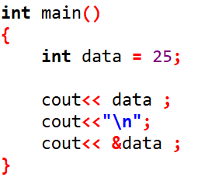
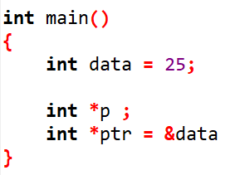
& - Address of operator * - Dereference operators
& Operator
Get the address of a variable
* Operator
Store the address of another variable
Make a variable into a pointer

Slide 18
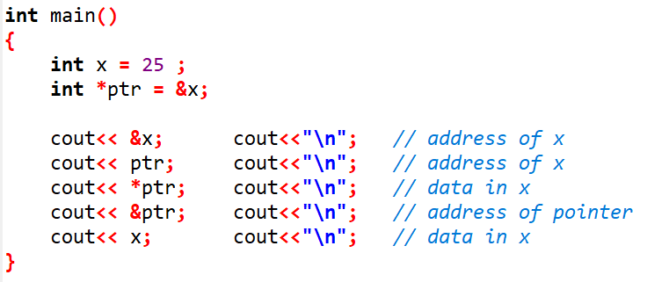

Slide 19
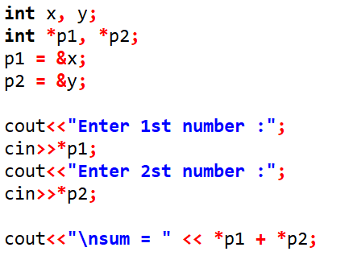
Write a program to add two numbers using pointer

Slide 20
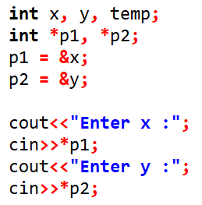
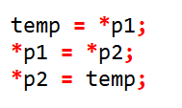
Write a program to swap two numbers using pointer

Slide 21
Memory Allocation
Static memory allocation
Dynamic memory allocation

Slide 22
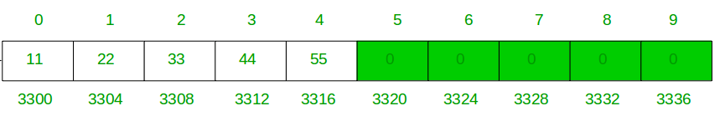
Static memory allocation
Variable memory allocation during compilation time is known as static memory allocation
It is fixed memory : once memory allocated ,it is fixed
Cannot expanded or reduced
Ex : Arrays
Int data[10] → 2 byte x 10 = 20 bytes

Slide 23
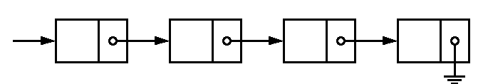
Dynamic memory allocation
Variable memory allocation during execution or run time is known as dynamic memory allocation
It is not fixed memory : once memory allocated ,it is not fixed
It can be expanded or reduced
It is done using NEW and Delete operators
Ex : Pinter

Slide 24


NEW and DELETE Operators
New operator is used to allocate memory during runtime
Unary operator
Delete operator is used to delete or de-allocate the memory during runtime
Unary operator

Slide 25
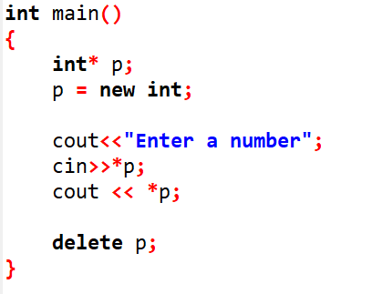
Example new & delete

Slide 26
Memory leak
Orphaned memory :
The memory allocated using the new operator forgot to de-allocate using delete operator, the memory is kept left unused.
Such memory blocks are called Orphaned memory
Each execution, the amount of orphaned blocks are increase
This situation is called memory leak
50
data
Reason for memory leak:
Forget to delete allocated memory
Multiple allocation to a pointer variable
1001
1001
1001
p
q
2001
3001

Slide 27
Operations on pointers

Slide 28
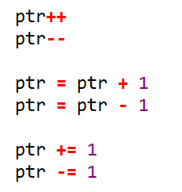
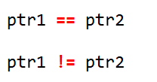
Arithmetic operation
Integer addition
Integer subtraction
Relational operation
Equal to
Not equal to

Slide 29
Pointer and Array

Slide 30
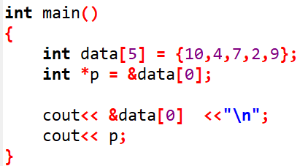
Pointer array
Array name is treated as pointer
Pointer points the First element of the array
10
4
7
data
1001
1002
1003
1001
p
2001

Slide 31
10
6
4
8
Dara
[0]
[1]
[2]
[3]
Data[0]
Data[1]
Data[2]
Data[3]

Slide 32
10
6
4
8
Dara
[0]
[1]
[2]
[3]
*(Data)
*(Data + 1)
*(Data + 2)
*(Data + 3)

Slide 33
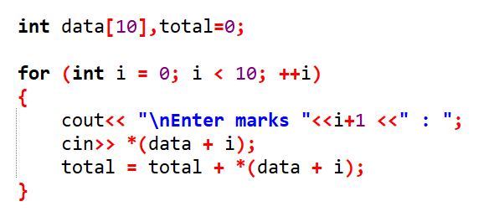
Write a program to add 10 students make using pointer array

Slide 34
Pointer and String

Slide 35
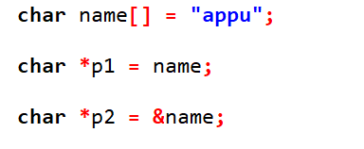
Pointer String
String is an array of character
Array name considered as string variable
No need to use & to assign pointer variable

Slide 36
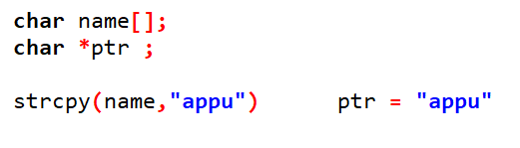
Advantages of character pointer
No need to specify the size
Assignment operator (=) is used to
copy a string ( No need strcpy )

Slide 37
Array of strings
Declare a character array as pointer

Slide 38
String Array V/s pointer string array
Normal string array declaration and initialization
pointer string array declaration and initialization

Slide 39
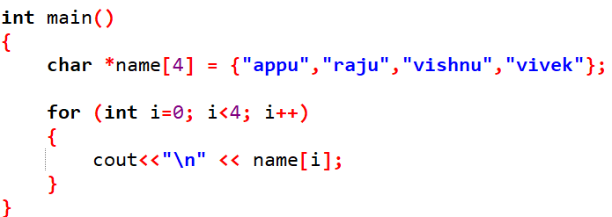
Example

Slide 40
Pointer and Structure

Slide 41
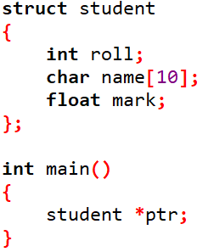
Structure pointer
A pointer declare with a structure name is known as structure pointer

Slide 42
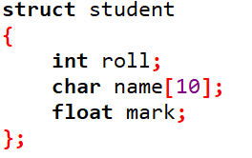
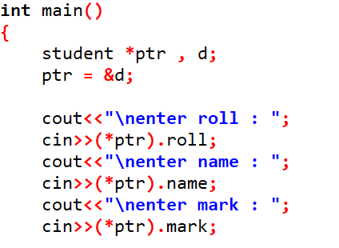
Using Struct variable and pointer

Slide 43
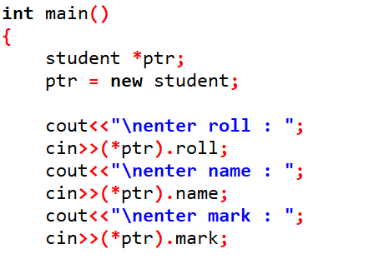
Using dynamic memory

Slide 44
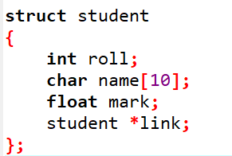
Self Referential Structure
Is a structure which one of the element is a pointer to the same structure

Slide 45


Reference operator V/s Dot Operator
Reference operator
Used to access data
Arrow like symbol ( -> )
syntax
Dot operator
Used to access address
dot symbol ( . )
syntax

Slide 46
